Slide 1
Do now
Complete the following sentences:
If voltage decreases, current will ___________________
If resistance increases, current will __________________
Solve the following for the unknown:
V=3V, I=3A, R=?
V=10V, R=1Ω, I=?

Slide 2
Types of circuits

Slide 3
aims
Learning objectives:
We will learn about series and parallel circuits
We will learn about fuses
Success criteria:
We will be able to draw an example of a series or parallel circuit
We will be able to explain the advantages and disadvantages of a series and parallel circuit
We will be able to explain how a fuse works

Slide 4
Series and parallel circuits
A series circuit is one in which there is only one pathway for the electrical current to go
A parallel circuit is one in which there are multiple pathways for the electrical current to go

Slide 5
What does it look like?
https://phet.colorado.edu/sims/html/circuit-construction-kit-dc/latest/circuit-construction-kit-dc_en.html
Notes:
When running this slide, demonstrate to students what happens in each circuit if there’s a random break in any of the globes (simply delete the globe)

Slide 6
Why should we care?
Series circuits:
Simple to make, simple to analyse
If one wire breaks, then the entire circuit is useless
Parallel circuits:
More complicated to make, even harder to analyse
If one wire breaks, then the circuit can still be useful
… but it gets weirder

Slide 7
Voltage drop
The voltage drop across resistors will decrease as you add more resistors in that pathway.
Voltage drop in one loop isn’t affected by the amount of different pathways.
More simply: light bulbs in series get dimmer the more bulbs you add, light bulbs in parallel don’t get dimmer

Slide 8
Voltage drop demonstration
https://phet.colorado.edu/sims/html/circuit-construction-kit-dc/latest/circuit-construction-kit-dc_en.html
Notes:
Demonstrate to students that though the battery is the same energy (both 9V), the light globes in parallel are a lot brighter

Slide 9
Simple table
 | Advantages | Disadvantages
Series Circuits | Simple to make; simple to analyse | If any part of the circuit breaks, the whole circuit stops; need more voltage for larger circuits
Parallel Circuits | If one part of the circuit breaks, the rest of the circuit keeps going; don’t need more voltage for large circuits | Complicated to make; extremely complicated to analyse

Slide 10
Cfu #1
Which of the following are parallel circuits? (may be multiple answers)
1. 2.
3. 4.

Slide 11
CFU #2
Which of the following is NOT an advantage of a parallel circuit?
One break won’t cause the circuit to stop working
Very easy to setup
Can use less power for multiple light bulbs
Light bulbs will be brighter than if put in series

Slide 12
CFU #3
If one street lamp goes out, all the rest stay on. Which of the following are correct?
They will be wired in parallel
They will be wired in series
The light bulb was high quality
A fuse broke

Slide 13
CFU #4
Two light bulbs are placed in a series circuit. Two other light bulbs are placed in a parallel circuit. Which will be brighter?
All will be the same brightness
The ones in series will glow brighter
The ones in parallel will glow brighter
They’ll all turn off

Slide 14
fuses
Fuses are safety features of circuits – if the current gets too high, the fuse will break (usually, literally)
If the current gets too high in a circuit, lots of bad things can happen:
The circuit can get incredibly hot and light on fire
If a wire is accidentally exposed, somebody could get shocked (higher current = more likely to be electrocuted)

Slide 15
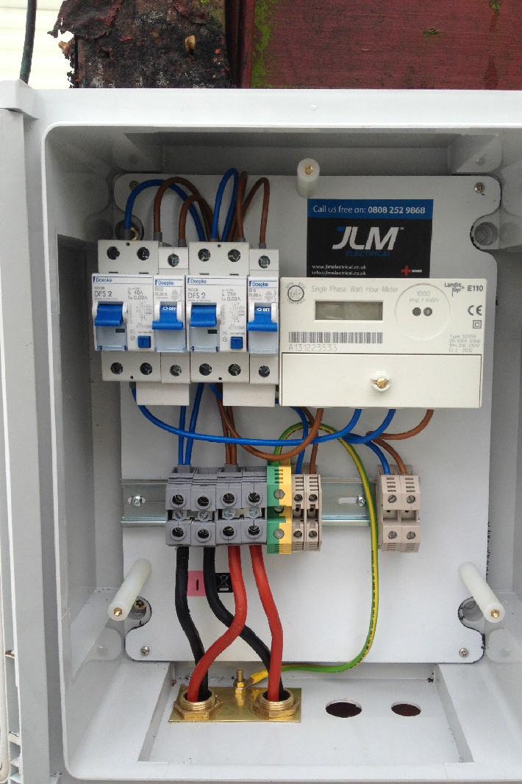
Circuit breakers
True fuses are one-time use only, and will need to be replaced, which can be costly.
Modern circuits use what is called a “circuit breaker” – just like a fuse, it disconnects the circuit if the current gets too high. However, these are reusable

Slide 16
CFU #5
How does a fuse work?
If there’s too much resistance, it breaks
If there’s too much voltage, it breaks
If there’s too much current, it breaks
It doesn’t

Slide 17
CFU #6
What is the difference between a circuit breaker and fuse?
Nothing; they’re identical
Circuit breakers need to be replaced regularly
Circuit breakers have a simpler design
Circuit breakers are reusable

Slide 18
aims
Learning objectives:
We will learn about series and parallel circuits
We will learn about fuses
Success criteria:
We will be able to draw an example of a series or parallel circuit
We will be able to explain the advantages and disadvantages of a series and parallel circuit
We will be able to explain how a fuse works

Slide 19
Independent working
Draw an example of a series and parallel circuit that both have 2 resistors, 1 light bulb, and a battery
Why would it be a bad idea to wire your house electronics using a series circuit?
How is it that every power outlet in a house can be 240 V?
If too many appliances are plugged into the same outlet, your circuit breakers may trigger. Why is that?

